Slide 1

PRACTICAL LECTURE
Software Design and Architecture
RANA TAIMUR KHAN
LECTURER GCUF

Slide 2
UNIFIED MODELING LANGUAGE
The Unified Modeling Language™ (UML) was developed jointly by Grady Booch, Ivar Jacobson, and Jim Rumbaugh with contributions from other leading methodologists, software vendors, and many users. The UML provides the application modeling language for:
  Process modeling/ Requirement Analysis with Use-cases.
  Static Design with Class and object modeling.
  Dynamic Design with sequence, collaboration and activity diagrams.
  Realtime Systems design models
  Distribution and deployment modeling.

Slide 3
PHASES OF SYSTEM DEVELOPMENT
Requirement Analysis
  The functionality users require from the system
  Use-case model
OO Analysis
  Discovering classes and relationships
  Class diagram
OO Design
  Result of Analysis expanded into technical solution
  Sequence diagram, state diagram, etc.
  Results in detailed specs for the coding phase
Implementation (Programming/coding)
  Models are converted into code
Testing
  Unit tests, integration tests, system tests and acceptance tests.

Slide 4
USE-CASE MODELING
In use-case modeling, the system is looked upon as a black box whose boundaries are defined by its functionality to external stimuli.
The actual description of the use-case is usually given in plain text. A popular notation promoted by UML is the stick figure notation.
We will look into the details of text representation later. Both visual and text representation are needed for a complete view.
A use-case model represents the use-case view of the system. A use-case view of a system may consist of many Use-case diagrams.
An use-case diagram shows (the system), the actors, the use-cases and the relationship among them.

Slide 5
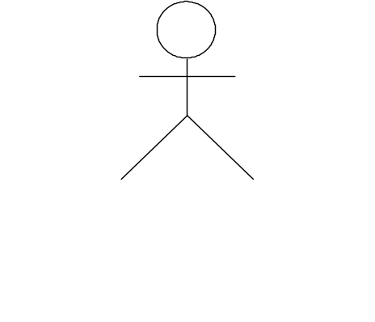
COMPONENTS OF USE-CASE MODEL
The components of a Use-case model are:
  System Modeled
  Actors
  Use-cases
  Stimulus
System Name
name
Use-case

Slide 6
SYSTEM
As a part of the use-case modeling, the boundaries of the system are developed.
System in the use-case diagram is a box with the name appearing on the top.
Define the scope of the system that you are going to design with your (software scope)

Slide 7
ACTORS
An actor is something or someone that interacts with the system.
Actor communicates with the system by sending and receiving messages.
An actor provides the stimulus to activate an Use-case.
Message sent by an actor may result in more messages to actors and to Use-cases.
Actors can be ranked: primary and secondary; passive and active.
Actor is a role not an individual instance.

Slide 8
FINDING ACTORS
The actors of a system can be identified by answering a number of questions:
  Who will use the functionality of the system?
  Who will maintain the system?
  What devices does the system need to handle?
  What other system does this system need to interact?
  Who or what has interest in the results of this system?

Slide 9
USE-CASES
A Use-case in UML is defined as a set of sequences of actions a system performs that yield an observable result of value to a particular actor.
Actions can involve communicating with number of actors as well as performing calculations and work inside the system.
A Use-case
  is always initiated by an actor.
  provides a value to an actor.
  must always be connected to at least one actor.
  must be a complete description.

Slide 10
FINDING USE-CASES
For each actor ask these questions:
  Which functions does the actor require from the system?
  What does the actor need to do?
  Could the actor’s work be simplified or made efficient by new functions in the system?
  What events are needed in the system?
  What are the problems with the existing systems?
  What are the inputs and outputs of the system?

Slide 11
DESCRIBING USE-CASES
Use-case Name:
Use-case Number: system#.diagram#.Use-case#
Authors:
Event(Stimulus):
Actors:
Overview: brief statement
Related Use-cases:
Typical Process description: Algorithm
Exceptions and how to handle exceptions:

Slide 12
EXAMPLE
Number: A.132.4
Name: Buy book online
Author: B.Ramamurthy
Event: Customer request one or more books
System: Amazon.com
Overview: Captures the process of purchasing one or more books and the transactions associated with it.
Related Use-case: A.132.5, A.132.8
Typical Process Description with exceptions handled.
NOTE : All these can be in a tabular form, say, in an Excel worksheet for example.

Slide 13
REALIZING USE-CASES
Validation is done up front. As soon as the model is ready it has to be presented and discussed with the customers.
Use-cases are implementation independent descriptions of the functionality of the system.
Use-case can be realized in the next stages of software development using, say, a class diagram.

Slide 14
INTERACTION BETWEEN USER AND USE-CASE
Insert
coins
Count
coins
Show/see
drinks
Show drink
N/A
Choose
drink
Deliver/pickup
drink

Slide 15
USE CASE DIAGRAM
Insert coins
<<uses>>
Count coins
Show/see drinks
<<uses>
Show drink N/A
Choose drink
Deliver/pickup drink

Slide 16
CASE STUDIES
  Ticket counter for basketball game
  TIVO: Video recorder/controller
  Weather Station.
  ATM Machine: Description given as data dictionary.
  4-cycle lawnmower engine
  Burger queen fast food restaurant’s hand-held order device

Slide 17
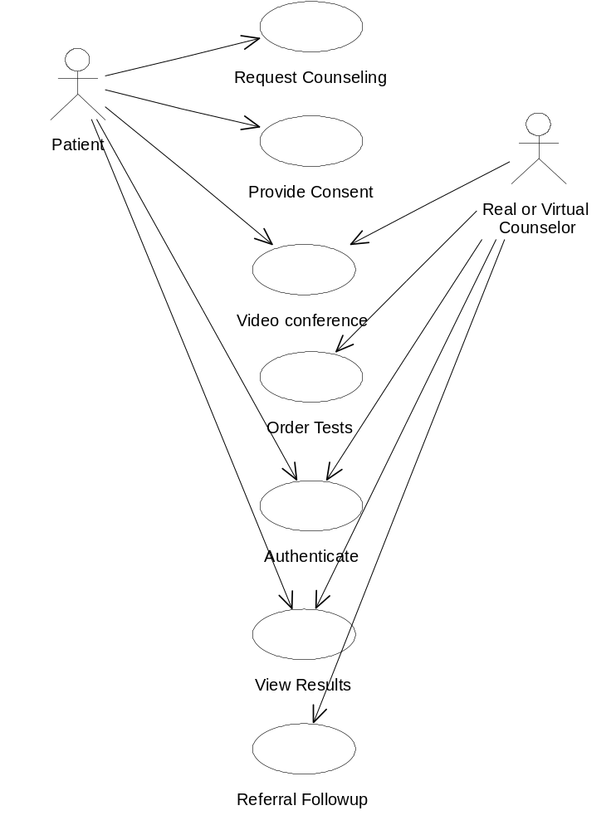
USE CASE EXAMPLE: COUNSELING

Slide 18
EXAMPLE
Carry out a use-case analysis of the operations performed by a parking ticket vending machine. Consider end-user (motorist), maintenance technician, auditor, and coin (money) collector.

Slide 19
SUMMARY : USE CASE MODEL
We studied the Use-case Model of Unified Modeling Language.
Use-case model provides a formal mechanism for carrying out a requirement analysis with active participation from domain experts and users who may or may not be software savvy.
Use-case model can be used not only for requirement analysis of software systems, hardware systems and hybrid (combination) systems.
Given a system, can you draw a use case diagram model.

